Slide 1
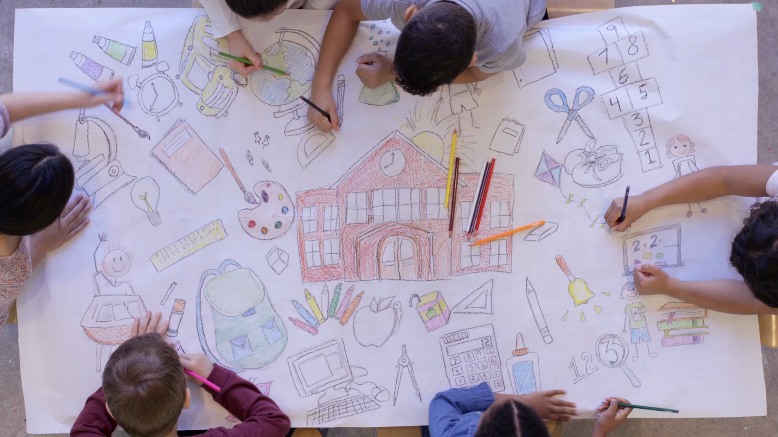
What makes learning fun ?
By IMAD CHAKOUR

Slide 2
Engagement:
Engagement is a vital element in making learning fun. When learners are actively involved in the learning process, their attention and interest are captured, leading to increased enjoyment. Interactive activities, hands-on experiments, simulations, and multimedia presentations are effective tools for engaging learners. These methods stimulate the senses, provide a dynamic learning environment, and make the educational experience more exciting.

Slide 3
Progress and Achievement:
A sense of progress and achievement contributes significantly to the enjoyment of learning. Breaking down complex concepts into manageable steps and setting clear goals and milestones enables learners to track their progress. Recognizing and celebrating achievements, whether big or small, provides a sense of accomplishment and reinforces motivation. Regular feedback and acknowledgment of effort or improvement foster a positive learning environment and make the learning journey more satisfying and enjoyable.

Slide 4
Personal relevance:
Learning becomes more enjoyable when you can see the direct relevance and application of the knowledge or skills being acquired to your own life. When you understand how it relates to your interests, goals, or real-world situations, it becomes more meaningful and engaging.

Slide 5
Humor and fun elements:
Incorporating humor, jokes, or light-hearted elements into the learning process can make it more enjoyable and help create a positive and relaxed atmosphere. Fun activities, games, or challenges that promote learning while entertaining can also enhance engagement.

Slide 6

Conclusion:
Making learning fun is a multifaceted endeavor that involves incorporating various elements and strategies. Engagement, personal relevance, collaboration, progress and achievement, and flexibility all contribute to creating an enjoyable learning experience. Educators should strive to design and implement interactive and meaningful activities, promote collaboration and social interaction, and provide opportunities for learner autonomy. By fostering a fun and engaging learning environment, educators can inspire a lifelong love for learning and maximize learners' potential.

